Slide 1

Cansat releaser v2
Preliminary design description
21/04/2016

Slide 2

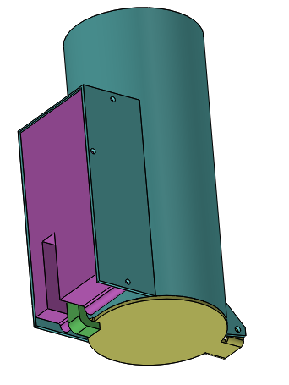
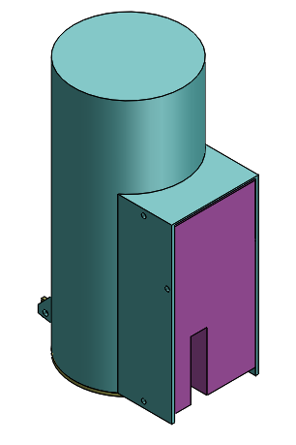
Cansat releaser description
Drone cables attachment points
Main tube
3 attachment points
For the electronics box
Electronics box
Latch mechanism
Spring loaded hinged door

Slide 3
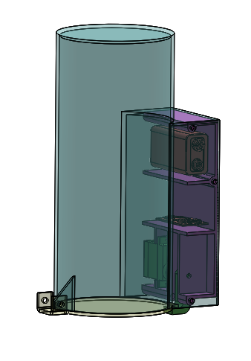
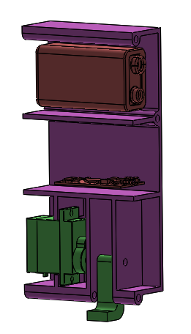
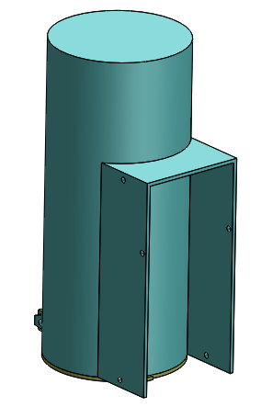
Cansat releaser electronic box description
9V battery
Switches location
Electronics
Servo
Latch mechanism
Releaser without electronics box

Slide 4
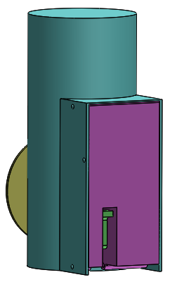
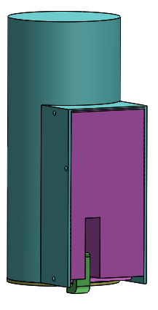
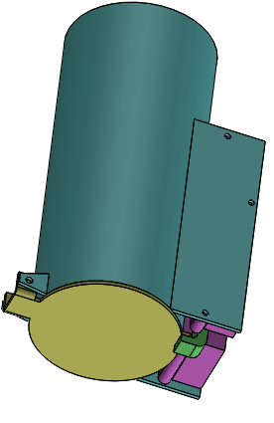
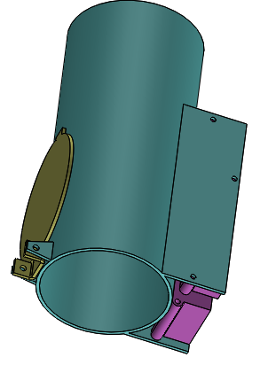
Cansat releaser opened/closed positions

Slide 5
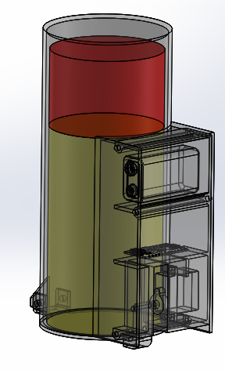
Cansat releaser with Cansat inside

